Slide 1
Surgical infections
Surgery Team
MED437
Team Leader: Rawan Mishal
Team Members: AlHanouf AlJaloud
Revised By: Arwa aljohany

Slide 2
Surgical Infections
Definition:
Infections that require surgical therapy
Infections that affect surgical patients
Infection Control and Preventive Measures
Hand hygiene; the most effective measure
Universal Precautions
Contact Isolation; MRSA, VRE, MDR-GNB
Avoid catheters; proper insertion and dressing, early removal Surgery less than 2 hrs no need for catheter, decrease lines whenever you can
Replace lines that were inserted without proper preparation ER, like central line that was done too fast
Careful dressing maintenance
Ventilator weaning; 1 day intubation = 1-3% risk of pneumonia
Selective use of antibiotic therapy
Surgical Infections Risk Factors:
Extremes of age (neonates, > 65 years of age)
Malnutrition
Obesity
Diabetes mellitus
Prior site irradiation
Hypothermia and hyperthermia
Hypoxemia
Coexisting infection remote to surgical site
Corticosteroid therapy
Recent operation, especially of chest or abdomen
Chronic inflammation
Hypocholesterolemia
Remember, Wash Your Hands.

Slide 3
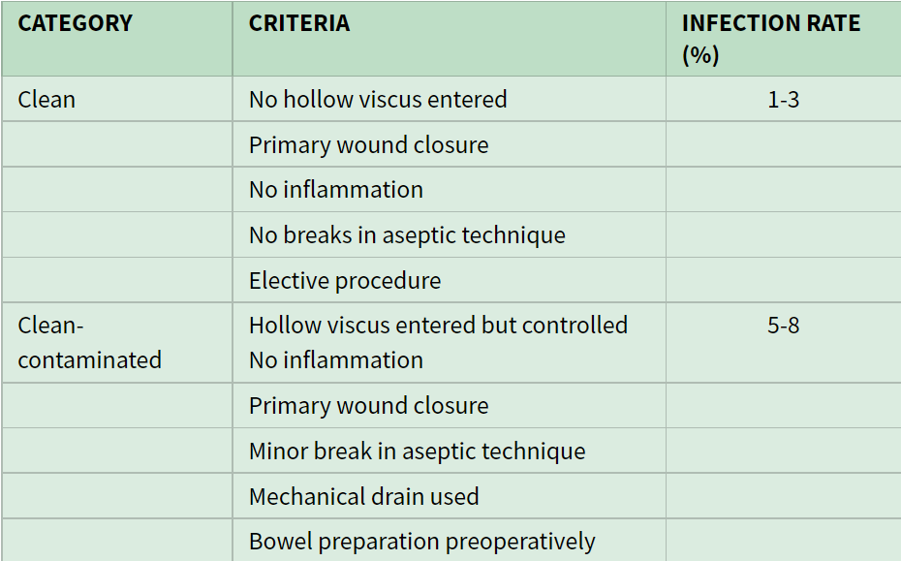
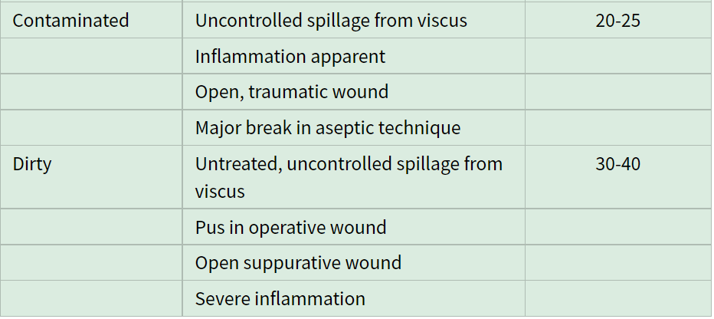
IMPORTANT
Classification of Surgical Wounds:
Principles of Antibiotic Therapy:
Preoperative antibiotic prophylaxis Within 60 minutes
Reduces surgical site infections (SSI)
Does NOT reduce nosocomial infections post op
Indicated for most clean-contaminated or contaminated procedures
Indicated for clean procedure with prosthetic grafts Drain, line, patch
First-Gen Cephalosporins is preferred. Cefazolin
Clindamycin is used for penicillin-allergic patients
Second-Gen Cephalosporins is used to cover GN or anaerobes (could be covered by first-Gen + metronidazole)
Should be giving within 1 hour of surgical incision; re-dose every 3-4 hours intraoperatively
Careful clinical evaluation
Empirical therapy – with high suspicion
Cultures BEFORE starting antibiotics 2 cultures guided therapy
Clinical- and culture-guided therapy
Lipoma, thyroid
Cholecystectomy
Bariatric, appendectomy.
Specially when you prick and you get fluid
Specially in redo surgery
Stab wound, ask about tetanus
Risk of infection in any vascular surgery is 30%
Cause most of them are close to dirty areas like groin
Stab wound but you can see bowel and it is open

Slide 4
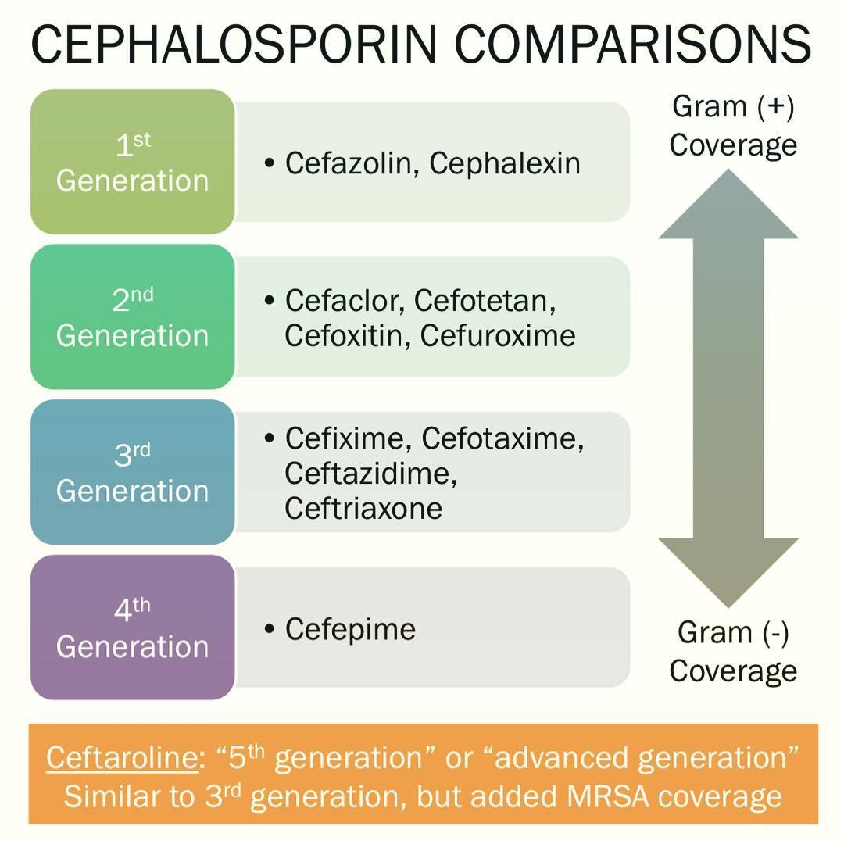
Factors Influencing Antibiotic Choice
Agent/Pathogen factors
Activity against known/suspected pathogens
Disease believed responsible
Infection vs colonization
Narrow-spectrum coverage best
Antimicrobial resistance patterns
Patient factors:
Severity of illness
Age
Immunosuppression
Organ dysfunction
Allergy
Surgical Site Infection (SSI)
A clinical diagnosis
Most common cause of delay in wound healing
Superficial: Skin and subcutaneous tissues
Deep: Fascia and muscle
Organ space: Internal organs (cavities)
Rare in the first few days after surgery EXCEPT necrotizing soft tissue infection (necrotizing fasciitis) very painful it relieved by GA only!
Caused by S. pyogenes or C. perfringens
They could appear in the first 24 hours
Necrotizing fasciitis is a surgical emergency; delay increases mortality
Presenting symptoms and signs depend on the depth of infection:
Pain-related immobility, wound drainage, crepitus, blisters/bullae
Systemic Inflammatory Response Syndrome (SIRS) / Sepsis
Organ specific symptoms
Management
Local wound care
Antibiotics
Imaging
Formal debridement
Drainage
Healing by secondary intention Abdominal dehiscence, Rupture aneurysm aortoduodenal fistula, In these cases leave it open to check every other day If the opening happened because of infection you do not close it
IMPORTANT SLIDE
anti-pseudomonal

Slide 5
Urinary Tract Infection (UTI)
Rare in non-catheterized patients in ICU
Bacteriuria/Candiduria +/- Pyuria ≠ established surgical infection
In ICU, MDR are more common to cause UTI in catheterized patient
Prevention
Avoid catheterization, if possible
Short catheter duration (< 48 hours)
Careful catheter care (e.g. insert with sterile gloves)
Postoperative Pneumonia
Ventilator-associated pneumonia (VAP)
Occurs 2-3 days after intubation
Most common surgical infection in ICU
Late VAP (> 5 days); likely by MDR bacteria
Prevention
Avoid, if possible
Shorter intubation duration
Orotracheal better than nasotracheal
Standard weaning protocols
Central Line–Associated Bloodstream Infection (CLABSI)
S. Epidermidis and other GBC – most common
A single +ve culture could be a contaminant
GNB: less common, but almost never contaminants
Fungal CLABSI: in critically ill patients at risk
Treatment
Catheter removal
Antibiotic course – usually long
Prevention
Proper insertion techniques
Intra-Abdominal Infection
Usually following abdominal surgery
Abscess vs general peritonitis
Clinical manifestations variable
Treatment:
Broad-spectrum antibiotics
Drainage, surgical intervention, or both
Delay causes higher morbidity and mortality
Notes:
- any suspected symptom of line infection specially central line you need to check it fast specially to rule out infective endocarditis
- you take a sample from line and sample from another location If one was positive probably its bad technique

Slide 6
Other Surgical Infection Pathogens
Vancomycin-resistant Enterococci (VRE)
Methicillin-resistant S. Aureus (MRSA)
Pseudomonas aeruginosa
Multidrug-Resistant Enterobacteriaceae, e.g. Klebsiella
Acinetobacter baumannii
Fungal infection
Susceptible patients
Prolonged hospitalization
Critically ill
Prolonged ICU stay/intubation
Multi-organ involvement
Multiple courses of antibiotics
Surgical Infections
Remains a major cause of morbidity – and mortality
Relatively, the deeper you get, the higher chance of getting infection
Any proven infection needs pathogen-directed therapy
Avoid or limit use of lines, tubes, and catheters.
Remove them if infected
Prevention the is the best management strategy
Wash Your Hands!
Notes:
Q: 62 year old female came with fever hypotension and all symptoms of UTI, she was admitted 7 times before with sepsis due to pyelonephritis, kidney is non functioning, you put nephrostomy tube, on Abx, after a day she got better, after a week discharged, after 2 weeks, loss of appetite and weak, the port for the drain is not good, you took urine for culture:
A. Pseudo B. Klebsiella C. VRE D. Negative culture
Most likely D negative culture because recurrent infections because she is taking piperacillin tazobactam
What will you do now?
A. Stop Abx
B. Change
C. Take out the drain and offer nephrectomy for non functional kidney infection with Abx
D. Admission and exchange of nephrostomy of tube
Definitive management? Answer C

Slide 7
Notes:
Q. Sebaceous cyst boil, ER removed it, he itched his head, it turned out red on edges of stitches, dr said its cool, then it all become red, he felt dizzy, discharge and pus and one of the sutures is out
You need to worry of deep infection, do culture CTA MRI rule out meningitis and treat empirically
Q. 36 year old drunk Stab wound and removed it, BP is 40, resuscitated, They call you, think of artery, vein and tetanus shot and broad spectrum Abx
Q. ACL
Intra OP the Dr sneezed, he should remove scope and make sure pt is on ABx
Notes:
1. Open aneurysm repair with foley catheter , medically stable after surgery , they removed all types of catheter , 3 days later , the patient complaint of Burning sensation, dysuria, Treat or not ?
You should treat since the pt had graft “ if it was bacteremia and reached the graft it will destroy it “If no graft you may wait ” up to clinical picture “
2. Young female with appendicitis symptoms, tender abdomen ,temp 38 for 24 Hours
Lab appendectomy , complicated with perforation and contamination You washed out everything 2 weeks later , pt comes and complaint of abdominal pain , less appetite
Examination revealed mild tenderness, not Febrile , Dx : SSI “clinical diagnosis “
Do CT or ultrasound “ looking for abscess “
3. Pt complaint of bowel obstruction with vomiting, the intern tried to put an NG tube , but it goes to the lung instead , he removed it and try to put another one and it was successful , 2 days later pt complaint of shortness of breath, fever. What the most important measure that could prevent this from happening?
Wash hand or hand hygiene

