Slide 1
Trauma
Surgery Team
MED437
Team Leader: Rawan Mishal
Team Members: Munira Almasaad
Revised By: Arwa aljohany

Slide 2
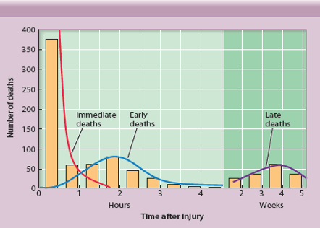
Goals/ Principles of Trauma Care
Rapid, accurate, and physiologic assessment
Resuscitate immediately before knowing the diagnosis, stabilize, and monitor by priority
Prepare for transfer to definitive care
Teamwork for optimal, safe patient care
TEAM
The Need for Early TEAM
Leading cause of death in ages 1 through 44
Disabilities exceed deaths by ratio of 3:1
Trauma-related costs > $400 billion per year
Lack of public awareness for injury prevention
Trimodal Death Distribution
Notes:
Most deaths occur in the first hour
Traumas leads to Death in 3, phases:
1- immediate death "most common” ⇒ very difficult to prevent it by hospital, the best way to prevent this is by preventing the injury itself
2- if patient survive the first phase ⇒ early death, here where trauma code get activated "they have massive injury but still alive"
3-late deaths complications "e.g. Traumatic Brain injury patients after that they develop pneumonia and die"

Slide 3
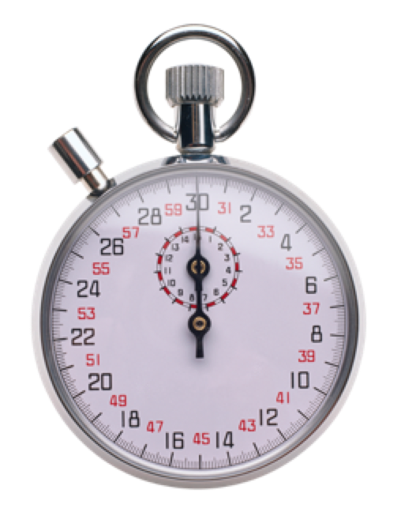
TEAM Principles
Treat greatest threat to life first
Definitive diagnosis less important
Physiologic approach
Time is of the essence
Do no further harm
Teamwork required for TEAM to succeed
TEAM Approach
Airway with c-spine protection
Breathing / ventilation to decrease CO2 / oxygenation
Circulation: Stop the bleeding!
Disability (neuro status)
Expose/ Environment/ body temp
TEAM Sequence
Notes:
Cervical collar => c-spine injury
leg roll => to avoid spinal injury
Cover the pt with blanket => to avoid hypothermia =>coagulopathy => more bleeding
Definitive care
Rapid primary survey ABCDE + Adjuncts
Must finish primary survey before leaving the patient
Safe transfer
If no staff is available
Detailed secondary survey/ reevaluation
Head-to-toe + Adjuncts

Slide 4
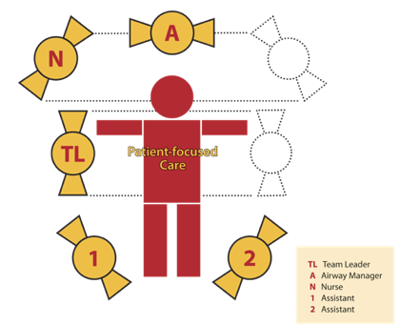
TEAM Sequence and Teamwork
Simultaneous primary survey and resuscitation of vital functions
Simultaneous secondary survey and reevaluation of vital functions
“TEAM” Work and Teamwork
Together Everyone Achieves More
Pre-hospital Preparation
C-spine protection at the scene
EMS should communicate with the hospital
Closest appropriate facility go to the most appropriate hospital even if it is further, it shouldn’t be the nearest one this is to give best chance for patient
Transport guidelines/ protocols
On-line medical direction
Mobilization of resources
Periodic review of care
Leader is here
Notes:
In real life we know each person where to stand: Trauma team leader => edge of the Bed
Primary survey => Right side of pt
Airway Team => head of pt
Circulating nurse, nurse who put IV=> Left side

Slide 5
In-hospital Preparation
Pre-planning essential plan the staff and duties before the trauma arrives
Team approach
Trained personnel
Proper equipment
Lab / x-ray capabilities
Standard precautions you have to protect yourself
Transfer agreements
QI Program
Standard Precautions
Protection of the staff is important
Triage
(primary survey) treat the patient according to the level (1-5)
Sorting of patients according to
ABCDE’s this is the best way to triage the Pts
Available resources
Other factors, e.g., salvageability
Primary Survey is the same for all patients
Priorities are the same for all! All ages, pregnant or not do the same steps
Airway / C-spine protection
Breathing / Life-threatening chest injury
Circulation / Stop the bleeding
Disability / Intracranial mass lesion
Exposure / Environment/ Body temp
Cap
Gown
Gloves
Mask
Shoe covers
Goggles / face shield

Slide 6
Special Considerations:
Children
The difference in children is that there system is immature, they maintain their vitals until they suddenly crash
Leading cause of death is trauma in children
Immature, anatomic/ mechanical features
Vigorous physiologic response they have normal vital signs even with trauma then they suddenly collapse
Limited physiologic reserve
Outcome depends on early aggressive care
Size, dosage, equipment, surface area, and psychology to prevent further trauma use right size materials, their trachea is short so you have to calculate the endotracheal tube
Airway: Larynx anterior and cephalad, short tracheal length
Breathing: Chest wall pliability (chest wall is flexible so they may have normal ribs but under it they have injury to the lungs and liver an so on), mediastinal mobility
Circulation: Vascular access, fluid volume, vital signs, and urinary output you have to calculate the volume of blood transfused unlike the adults
Neurologic: Vomiting, seizures, and diffuse brain injury you could have very bad brain injury but no skull fracture
Musculoskeletal: Immature skeleton, fracture patterns
Pregnancy
They have minimal counts of WBC, anemia, low physiological reserve
Anatomic/ physiologic changes modify response to injury
Need for fetal assessment
1st Priority: Maternal resuscitation RESUSCITATE THE MOTHER THEN THE BABY
Outcome depends on early, aggressive care
Gestation and position of uterus
Physiologic anemia
↓ Pco2 ( rapid shallow breathing)
↓ Gastric emptying
Supine hypotension
Notes:
- children brain does not have space like the adults so any edema will cause fast increase in the ICP
- children are not small adults their anatomy, physiology, and even the way they response to injury is different
- even their physiological response is different they don’t have physiological reserve they use it aggressively then they crash
- in adults they may develop tachycardia and hypotension then either improves / worsen before they crash, but in children if they have trauma they go from normal to crash because their physiology is strong so it stays normal then falls down and suddenly crash

Slide 7
Isoimmunization Rh isoimmunization if the trauma is 12 weeks or above
Sensitivity of fetus
Elders
Their bodies are already at overload so any injury will affect them
5th leading cause of death
Diminished physiologic reserve and response
Comorbidities: Diseases/ Medications
Outcome depends on early, aggressive care
Primary Survey:
Airway
Talk to the patient, check for noisy breathing or gurgling
Assess for airway patency Snoring
Gurgling
Stridor
Rocking chest wall motions
Maxillofacial trauma/ laryngeal injury / Dislocation of Jaw/ Hematoma
Caution: C-Spine Injury
Resuscitation: Patent Airway
Chin lift/ Modified jaw thrust
Look, listen, feel
Remove particulate matter
Definitive airway as necessary intubation, as first responder faster to clean the airway by suction or oropharyngeal tube
Reassess frequently
Caution: C-Spine Injury
- 10 weeks pregnant what will you do?
treat the mom, nothing else is indicated you might do an US later just to be safe
- if older than 20 weeks you need fetal monitoring
Important
- from 14-16 weeks => fetal assessment
- after 20 week => fetal monitoring
- as early as 12 week => rhesus compatibility why? if there is an injury there may be fetal-maternal blood mix
- 12 weeks, you don't have to do fetal monitoring it is too early
- Is he talking? He is good, If he is snoring, gurgling, فقاعات، stridor = not good
- securing the airway does not always mean intubation

Slide 8
Breathing
Put the pt on O2 we need maximum O2 saturation no time to worry for O2 toxicity
Resuscitation: Assess Breathing
Chest rise and symmetry
Air entry
Rate/ Effort
Color/ Sensorium
Caution: Tension / open pneumothorax
Resuscitation: Breathing
Administer supplemental oxygen Bag mask is done until expert does intubation
Ventilate as needed
Tension pneumothorax: Needle decompression Chest tube + Finger thoracostomy
Open pneumothorax: Occlusive dressing Dressing then chest tube Air will go out but not in
Reassess frequently airway and breathing need to be reassessed always
- Perform Suctioning if there is teeth trauma
- Securing airway no need for intubation (use mouthpiece or chin lift)
- Definitive airway need intubation
- Chin lift has risk of Cervical injury
- If definitive airway you can take him to CT or wherever, But if just opening it be careful
- if the pt is not conscious the jaw and tongue may fall down and close the airway so you need to lift the jaw
- Tension pneumothorax: needle is a life saving But chest tube and finger thoracotomy is better nowadays
- Open pneumothorax: You close it to make it simple pneumothorax
- anything other than simple pneumothorax will make patient not Breathing so treat it in Breathing

Slide 9
Circulation
Caution:
Children "may be normal But they are bleeding”
Elderly "may take meds that blocks these signs like BB, antihypertensive...”
Athletes "they have huge reserve they could lose blood however they are stable ,we see it in workers they fall from height / nail gun injury/ other big injury but stable ,don’t let them fool you they are vitally stable but they are not well"
Pregnancy
Medications
Non hemorrhagic shock
however treat initially as hemorrhage by 2 large pore, give fluid, 2L of Blood
Cardiac tamponade
Tension pneumothorax increasing pressure into the chest which will lead to closing of the veins => Venous pressure increases causing => low venous return => Causing tachy and hypo
Neurogenic Bradycardia and Hypotension!
Septic (late)
- Young healthy adults tolerate a loooot of bleeding before deteriorating, So resuscitate whenever you see any sign of bleeding
- While resuscitating R/O bleeding
There are 4 sites that may cause shock:
1- abdomen “FAST” 2- chest hemothorax “CXR” 3- open pelvis 4- long bone fracture
- Bleeding in head does not cause shock
-Bleeding in cavities is what causes shock the cavities are: abdomen, chest, open pelvis.
- Long bone fracture is non-cavity bleeding sometimes femur bleed 2-3 L maximum until it fills then stop so they respond well to resuscitation however if there is no response look for bleeding in other cavities
Tension pneumothorax causes circulatory problems because venous pressure will be more than 10 leading to closing of veins and loss of preload in heart

Slide 10
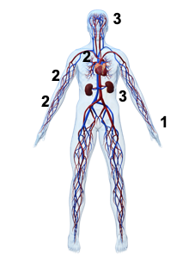
Assess organ perfusion
Level of consciousness anxious, agitated, confused
Skin color pale
Pulse rate and character
Tachycardia
Vasoconstriction
2. ↓ Cardiac output
2. Narrow pulse pressure
3. ↓ MAP
3. ↓ Blood flow
Resuscitation: Circulation
Bleeding? Find it then try to Stop it:
Direct pressure
Operation
Avoid blind clamping
Obtain venous access
Restore circulating volume
Ringer’s lactate, 1-2 L In any pt you need to give 1-2 L of ringer or Normal Saline to fix BP
PRBCs if transient response or no response
Reassess frequently
- Anxious and Agitated, signs of shock
- How to check organ perfusion? LOC, Pulse, Skin color, Urine output
- If clear bleeding direct pressure to stop it
- Bleeding in cavities:
- chest => Bilateral Chest tube and check abdome
- abdomen => FAST (US) if (+) => OR
- pelvis => if it moves (indicates fracture) =>pelvis binders => ex fix
- Pelvis? Tap and see if there is fluid then pelvic binder
- How to know if bleeding in abdomen? FAST (US) Then OR

Slide 11
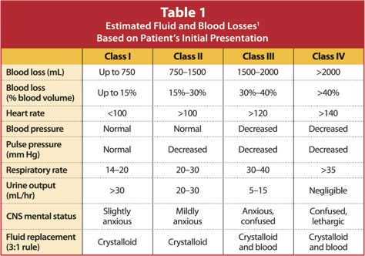
1^ For a 70-kg man.
Consider
Tension pneumothorax: Needle decompression and tube thoracostomy
Massive hemothorax: Volume resuscitation and tube thoracostomy
Cardiac tamponade: Pericardiocentesis and direct operative repair
Space occupying lesions need immediate management
Disability
Baseline neurologic evaluation
GCS Score
Pupillary response If one is dilated, there is bleeding in other side
Neurosurgical consult as indicated Motor Posture (Movement) MOST SIGNIFICANT
If you see any of this neurosurgery need to come right away and evacuate
Caution: Observe for neurologic deterioration
- What are the threat to life in Disability? Bleeding in head so look for the signs
Primary for neuro:
1- GCS Score. 2- Pupillary response. 3- localizing signs
- spinal cord injury is not life threatening we look for space occupying lesion

Slide 12
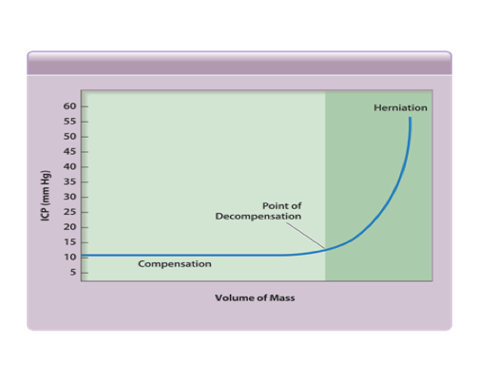
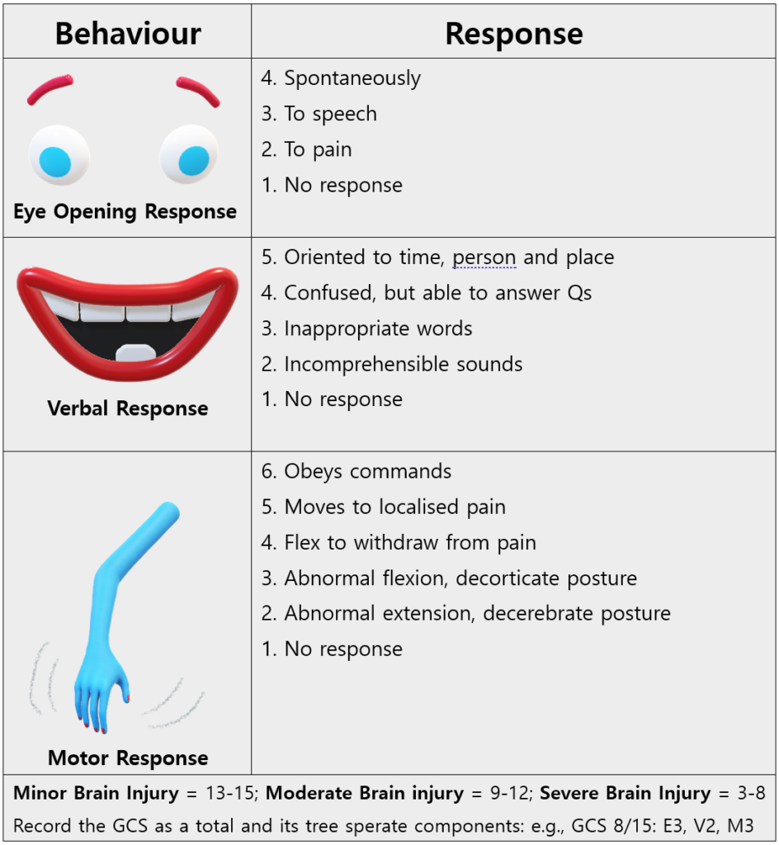
GCS Score
Eye opening: Range 1-4
BEST Motor response: Range 1-6
Verbal response: Range 1-5
Score = (E + M + V)
Best score = 15
Worst score = 3
Exposure
Completely undress the patient To look for other injury
Remove helmet if present
Look for visible / palpable injuries
Log roll, protect spine
Perform DRE look for: 1-Blood "indicate bleeding in bowel". 2-high- riding prostate. 3- tone
Caution: prevent hypothermia
TERTIARY SURVEY after everything gets stable and check private areas like groin
Resuscitation: Overview
If in doubt, establish definitive airway
Oxygen for all trauma patients
Chest tube may be definitive for chest injury
Stop the bleeding!
2 large-caliber IVs
Prevent hypothermia
Which part of GCS is most important in prognosis & everything? MOTOR RESPONSE IF THEY ASKED YOU IN EXAM
Extra

Slide 13
Adjuncts:
Urinary Catheter contraindicated in urethral injury
Blood?
Decompress bladder
Monitor urinary output 50 ml/ hour is a good indicator
Caution:
Blood at meatus sign of urethral injury we consult specialist if we couldn't do flolly cathetur we do suprapupic
Perineal ecchymosis/ hematoma
High-riding prostate
Gastric Catheter contraindicated in skull base injury
Blood or bile? sign bowel of injury
Decompress stomach
Caution:
CSF rhinorrhea / otorrhea
Periorbital ecchymosis
Mid-face instability
Hemotympanum
THESE ARE USED AFTER THE PRIMARY SURVEY
Monitoring
Vital signs
ABGs
ECG
Pulse oximetry
End-tidal CO2
Diagnostic Tools
Chest / pelvis x-ray
C-spine x-rays when appropriate CT used instead
FAST
DPL FAST used instead
Consider need for transfer
- Foley Catheter to monitor UO, except in cases of Urethral injury, Use NG tube instead
- f there is urethral injury do not put foley just consult uro
- So we like to put foley to monitor UO and NG to decompress stomach and check for blood, unless there is a contraindication to them

Slide 14
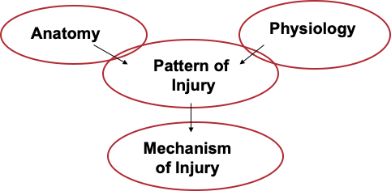
Secondary Survey
head-to-toe (ct here)
why? primary survey is for life threatening injury but we need to look for life affecting injuries (eg. pencil grasp)
"if the pt became unstable in secondary survey go back to primary"
Start After
Primary survey completed
Resuscitation in process
ABCDEs reassessed
Vital functions returning to normal
Key Parts Secondary survey to find missed injuries and non-life threatening injuries
AMPLE History
Complete physical exam: Head-to-toe
Complete neurologic exam
Special diagnostic tests CT
Reevaluation
History IMP OSCE take hx from trauma patient
A Allergies
M Medications Especially B-blockers, blood thinner
P Past illnesses / Pregnancy
L Last meal
E Events / Environment
Mechanism of Injury

Slide 15
Abdominal Trauma
Solid Organ Injury
Solid organ injury is a leading cause of significant morbidity and mortality following injury.
Identification of serious solid organ injury may be challenging.
Many injuries, however, manifest during the initial assessment and treatment period. Thus, early identification is essential.
Initial Assessment and Resuscitation
Primary Survey: Identification and treatment of life threatening injuries.
Airway with cervical spine precautions
Breathing
Circulation
Disability
Exposure
Abdominal assessment
Vital signs and physical exam
Investigational Studies
FAST
DPA/DPL
CT Abdomen/Pelvis
Most common solid organ injury “blunt”: Liver then spleen
Most common hollow organ injury “penetration”: Intestine “especially duodenum”
Notes:
-Blunt unstable ⇒ FAST: if +ve go for laparotomy , if -ve look for other sites "is it Tension pneumothorax/ pelvis fracture (pelvis bleeding is very difficult to control in OR it is better to do angio ex fix"
-Blunt stable ⇒ not imp to do FAST. why? if FAST is +ve/ -ve you will go for CT
-penetrating ⇒ not imp to do FAST. why? if FAST is + ve/ -ve you will go to OR

Slide 16
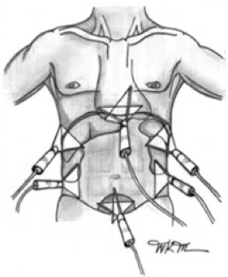
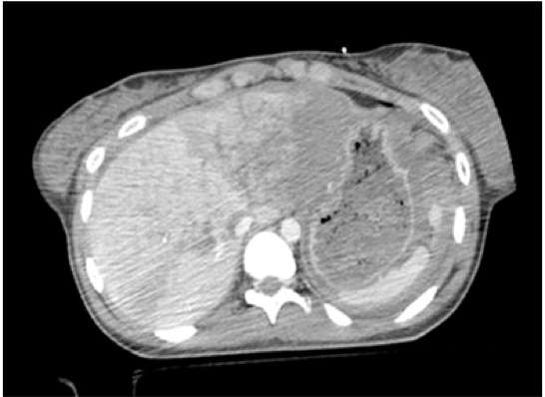
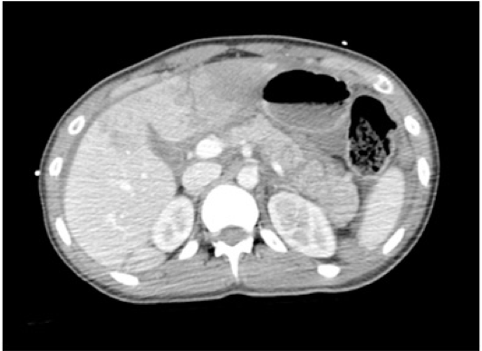
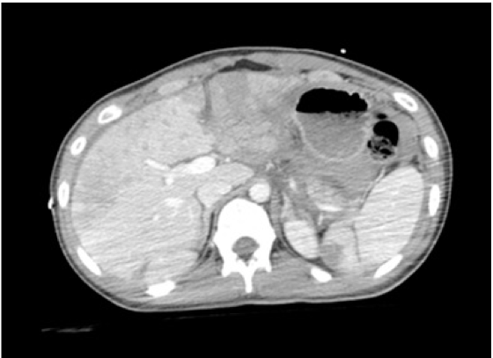
Focused Assessment with Sonography in Trauma (FAST) replaced DPL
Used around the abdomen
Any fluid found is most likely blood
First used in 1996
Rapid
Sensitivity 86-99%
May be able to detect as little as 100 ml of blood
Cost effective
Views: Pericardial, perihepatic, perisplenic, and peripelvic spaces.
User dependent with inherent limitations of ultrasound.
Useful in unstable patient
We see morison pouch, renal, bladder, pericardium
CT Scan
Gold standard. For solid organ diagnosis
Hemodynamically normal patients!
Provides excellent imagining of solid organs (liver and spleen).
Determines the source and amount of bleeding (angio phase).
Reveals associated injuries: pancreas, genitourinary.
Poor for hollow viscus injury. "in Bowel injury the CT shows signs that comes after inflammation and this take time to show"
liver, splenorenal space, bladder
- Useful in one scenario: UNSTAPLE blunt trauma patient, if staple go to CT
- Can be repeated as many times, safe to patient, but the problem is that it depends on experience of the Dr
- If penetrative do not do FAST go directly to OR
- If FAST (+) go to OR directly
- If bleeding in pelvis go to Angio not OR
UNSTABLE BLUNT TRAUMA > FAST IS BEST
STABLE BLUNT PATIENT > CT (Because I have time)
UNSTABLE PENETRATING TRAUMA > OR
Hypodense left lobe due to laceration

Slide 17
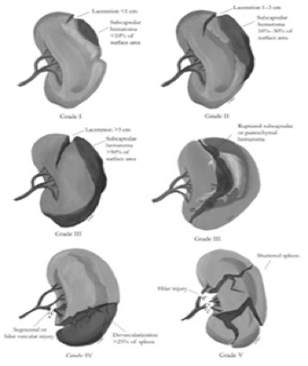
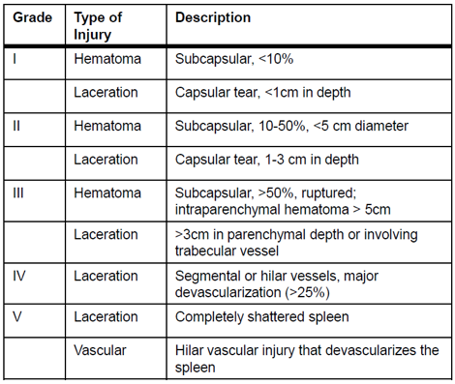
Solid Organ Injuries
Difficult to diagnose on physical exam
May lead to significant blood loss
Grading of solid organs dependent on degree of hematoma, laceration, or avulsion.
Injuries may present late, leading to further difficulty in assessment and management.
The most common solid organs injured spleen and liver.
Splenic Injuries
Key Principles
Hemodynamically unstable patients require immediate laparotomy.
Splenectomy
Non-operative management is an option in the hemodynamically stable patient ONLY. if not stable no need for CT go to OR for splenectomy
No patient should die as a consequence of non-operative management.
- GRADE 1,2 LOW, GRADE 3 Medium, GRADE 4, 5 HIGH GRADE
- This is for CT not OR high grade can become unstable if you don't take pt to OR But you can still do non operative management in high grades
- In unstable pts with spleen injury just remove
- If high grade put him in ICU and might do Angio to not become Unstable
- If non operative mgmt is indicated tell pt to avoid sports and stuff like that for 6-7 weeks
- unstable pt ⇒ laparotomy
- stable:
1- Grade 1,2 ⇒ ward
2-Grade 3,4,5 ⇒ ICU "because the chance of bleeding is high"
- in grade 4,5 ⇒ you may consider angioembolization even if pt is stable

Slide 18
is you decide not to do splenectomy the pt should not die it has to be in big center, do serial exam and Hg, once the pt become unstable you should be ready to go to OR, so in small center either you do splenectomy or Transfer to big center
Non Operative management
Intensive monitoring
Serial clinical exam, Hgb level.
High grade injury patients may require angiography +/- angioembolization to improve success rates.
Patients are told to avoid contact sports for a period of time ( up to 7 weeks). in children “2+ Grade of injury” e.g grade 4 “2+4=6” so 6 weeks with no sport buy in adults it is always 7 weeks
If the patient becomes hemodynamically unstable, or requires multiple transfusions, then this is considered failure.
Failure of NOM => laparotomy and splenectomy. By failure we mean Bleeding, Regular transfusion, unstable
GRADE 4 and 5 admit to ICU
Spleen injury without surgery need to avoid heavy sports
Any injury that causes unstable vitals > OR
Complications of NOM
Failure! Most common complication
Splenic ischemia, infection, abscess.
Chronic pain
Liver injuries You cannot resect liver so that is why it's dangerous but otherwise same mgmt as spleen
Classification
grade I
haematoma: subcapsular, <10% surface area
laceration: capsular tear, <1 cm parenchymal depth
grade II
haematoma: subcapsular, 10-50% surface area
haematoma: intraparenchymal <10 cm diameter
laceration: capsular tear 1-3 cm parenchymal depth, <10 cm length
grade III
haematoma: subcapsular, >50% surface area of ruptured subcapsular or parenchymal haematoma
haematoma: intraparenchymal >10 cm or expanding
laceration: capsular tear >3 cm parenchymal depth
grade IV
laceration: parenchymal disruption involving 25-75% hepatic lobe or involves 1-3 Couinaud segments
grade V
laceration: parenchymal disruption involving >75% of hepatic lobe or involves >3 Couinaud segments (within one lobe)
vascular: juxtahepatic venous injuries (retrohepatic vena cava / central major hepatic veins)
grade VI
vascular: hepatic avulsion
N.b. advance one grade for multiple injuries up to grade III.

Slide 19
Liver Injuries
in Liver injury most of the time the pt is stable 90% , if unstable go to OR
Similarly, regardless of grade, a trial of non-operative management is appropriate for stable patients.
Unstable patients laparotomy
packing.
packing + angio.
deep liver sutures.
balloon tamponade.
hemostatic agents.
hepatic artery ligation.
Laparotomy for continued blood loss with hypotension, tachycardia, decrease urine output, and decreasing HCT.
Operative rate: good prognosis
3-11% with multiple injuries
0-3% when isolated
Biliary Tree Injury
4% incidence of continued bile leak. Increased 10 fold in Grade IV and V injuries.
ERCP with decompression and stenting may be both diagnostic and therapeutic. Chronic Liver Injury will cause Biloma and Bile Leak ERCP to compress the bile duct and remove the leak
May require operative washout for delayed bile leak and peritonitis.
Other Complications
Failure!
Liver ischemia, infection, abscess
Biliary leak, biloma, peritonitis.
- Cannot remove the liver like the spleen so packing, packing, packing then angio
- Spleen can have abscess and ischemia but liver no
- Liver can have biliary tree injury and can have bile leak & biloma, We treat it when pt is stable we do ERCP to fix it
- Bile leak will need treatment
- The pt will have pain, high bilirubin, US/CT will show fluid, drain the fluid you will see bile

Slide 20
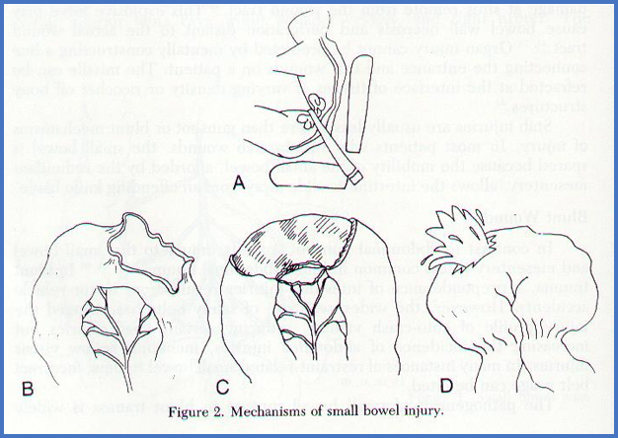
Bowel Injury
Unrecognized : frequent cause of preventable death after few day will Present with Peritonitis
Blunt
Penetrating: Stab, Gunshot Small Bowel is More Common in Penetrating Trauma Blunt is Solid organs (Liver, Spleen)
Operative
Mechanism
Crushing: Compression
Shearing: Sudden Deceleration
Bursting: increase Abdominal Pressure
Causes:
Motor – Vehicle: 75%
Fall from Heights
Seat Belt
Penetrating Perforated Intra Abdominal Viscus is the most common cause of Peritonitis
Symptoms and Signs:
Unreliable Bowel injury can be masked So DRE and NG blood or peritonitis are what tells you
Often Masked:
Head Injury
Major Fractures
Alcohol
Spinal cord injury
Signs:
Echymosis & Abrasions
Tender ribs
Peritonitis
Tenderness and Guarding : 75%
Rebound and Rigidity: 28%
DRE
Blood
- small bowel perforation is hard to diagnose, pt presents with peritonitis and sepsis, how do we prevent? Frequent examination “If pt is sedated it will be harder”, So if you see peritonitis think bowel injury “EXAM”
- The problem with bowel injury that it does not show early on ct so if you suspect it admit the patient and do serial physical examination and see if he develop peritoneal signs

Slide 21
- Any sign of abdominal issue you think of bowel injury
- Peritonitis, blood in NG, blood in DRE guarding and rigidity
- If: blood in NG OR blood in DRE OR peritonitis think of bowel injury
Management:
Needs operative management
If <50% and non destructive, primary repair.
If >50% or destructive, resection and anastomosis.
- Repair is easy by primary repair
- If destructive by gunshot or something resection and anastomosis

